Slide 1
Android Learning Summary
Chaojun Lu/2017-08-28

Slide 2
Agenda
Introduce Android
Basic Framework
Introduce the knowledage which I learned
Programme 1: Call Phone
Programme 2: Get Website Picture
Programme 3: Send Message

Slide 3
Introduce Android
Who developed Android？
Android was developed by Andy Rubin
Designing Android use some languages
Linux Kernel was designed by C/C++
Application FrameWork was designed by JAVA
Open source
Many Open Source Projects are listed on github
Rich ecosystem and very active community

Slide 4
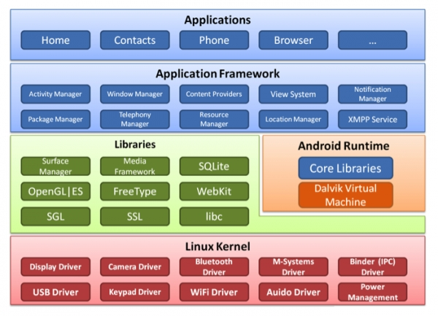
Basic Framework

Slide 5
Introduce the knowledage which I learned
1. Toast
Toast.makeText(getApplication,text,Toast.LENGTH_LONG). show();
2. Intent
Intent intent = new Intent();
3. LinearLayout and RelativeLayout
4. openFileoutput
FileOutputStream fos =getApplication().openFileOutput(String name, int mode)
Notes:
official link for the installation instructions as below,
https://github.com/robotframework/robotframework/blob/master/INSTALL.rst

Slide 6
Introduce the knowledage which I learned
5. get sdcard path
Environment.getExternalStorageDirectory().getPath();
6. SharedPerferences
SharedPreference sp = getSharedPreferences(“config”,0);
Editor edit = sp.edit();
edit.putString(“”,””);
edit.commit();
7. XmlSerializer and XmlPullParser
XmlSerializer xs = Xml.newSerializer();
xmlPullParser xp = Xml.newPullParser();

Slide 7
Introduce the knowledage which I learned
8. Android's database
public class MyOpenHelper extends SQLiteOpenHelper{
}
9. listview
listview.setAdapter(new MyListAdapter());
10. inflate
View.inflate(MainActivity.this,R.layout.item,null);

Slide 8
Introduce the knowledage which I learned
11. BaseAdapter,ArrayAdapter and SimpleAdapter
12. Android Internet
URL url = new URL(path);
HttpURLConnection conn = (HttpURLConnection)
url.openConnection();
conn.setRequestMethod(“get”);
conn.setConnectionTimeout(5000);
int code = conn.getResponseCode();
13. handler

Slide 9
Introduce the knowledage which I learned
14. Open Programmes of SmartImageView and asyncHttpClient
15. Activity

Slide 10
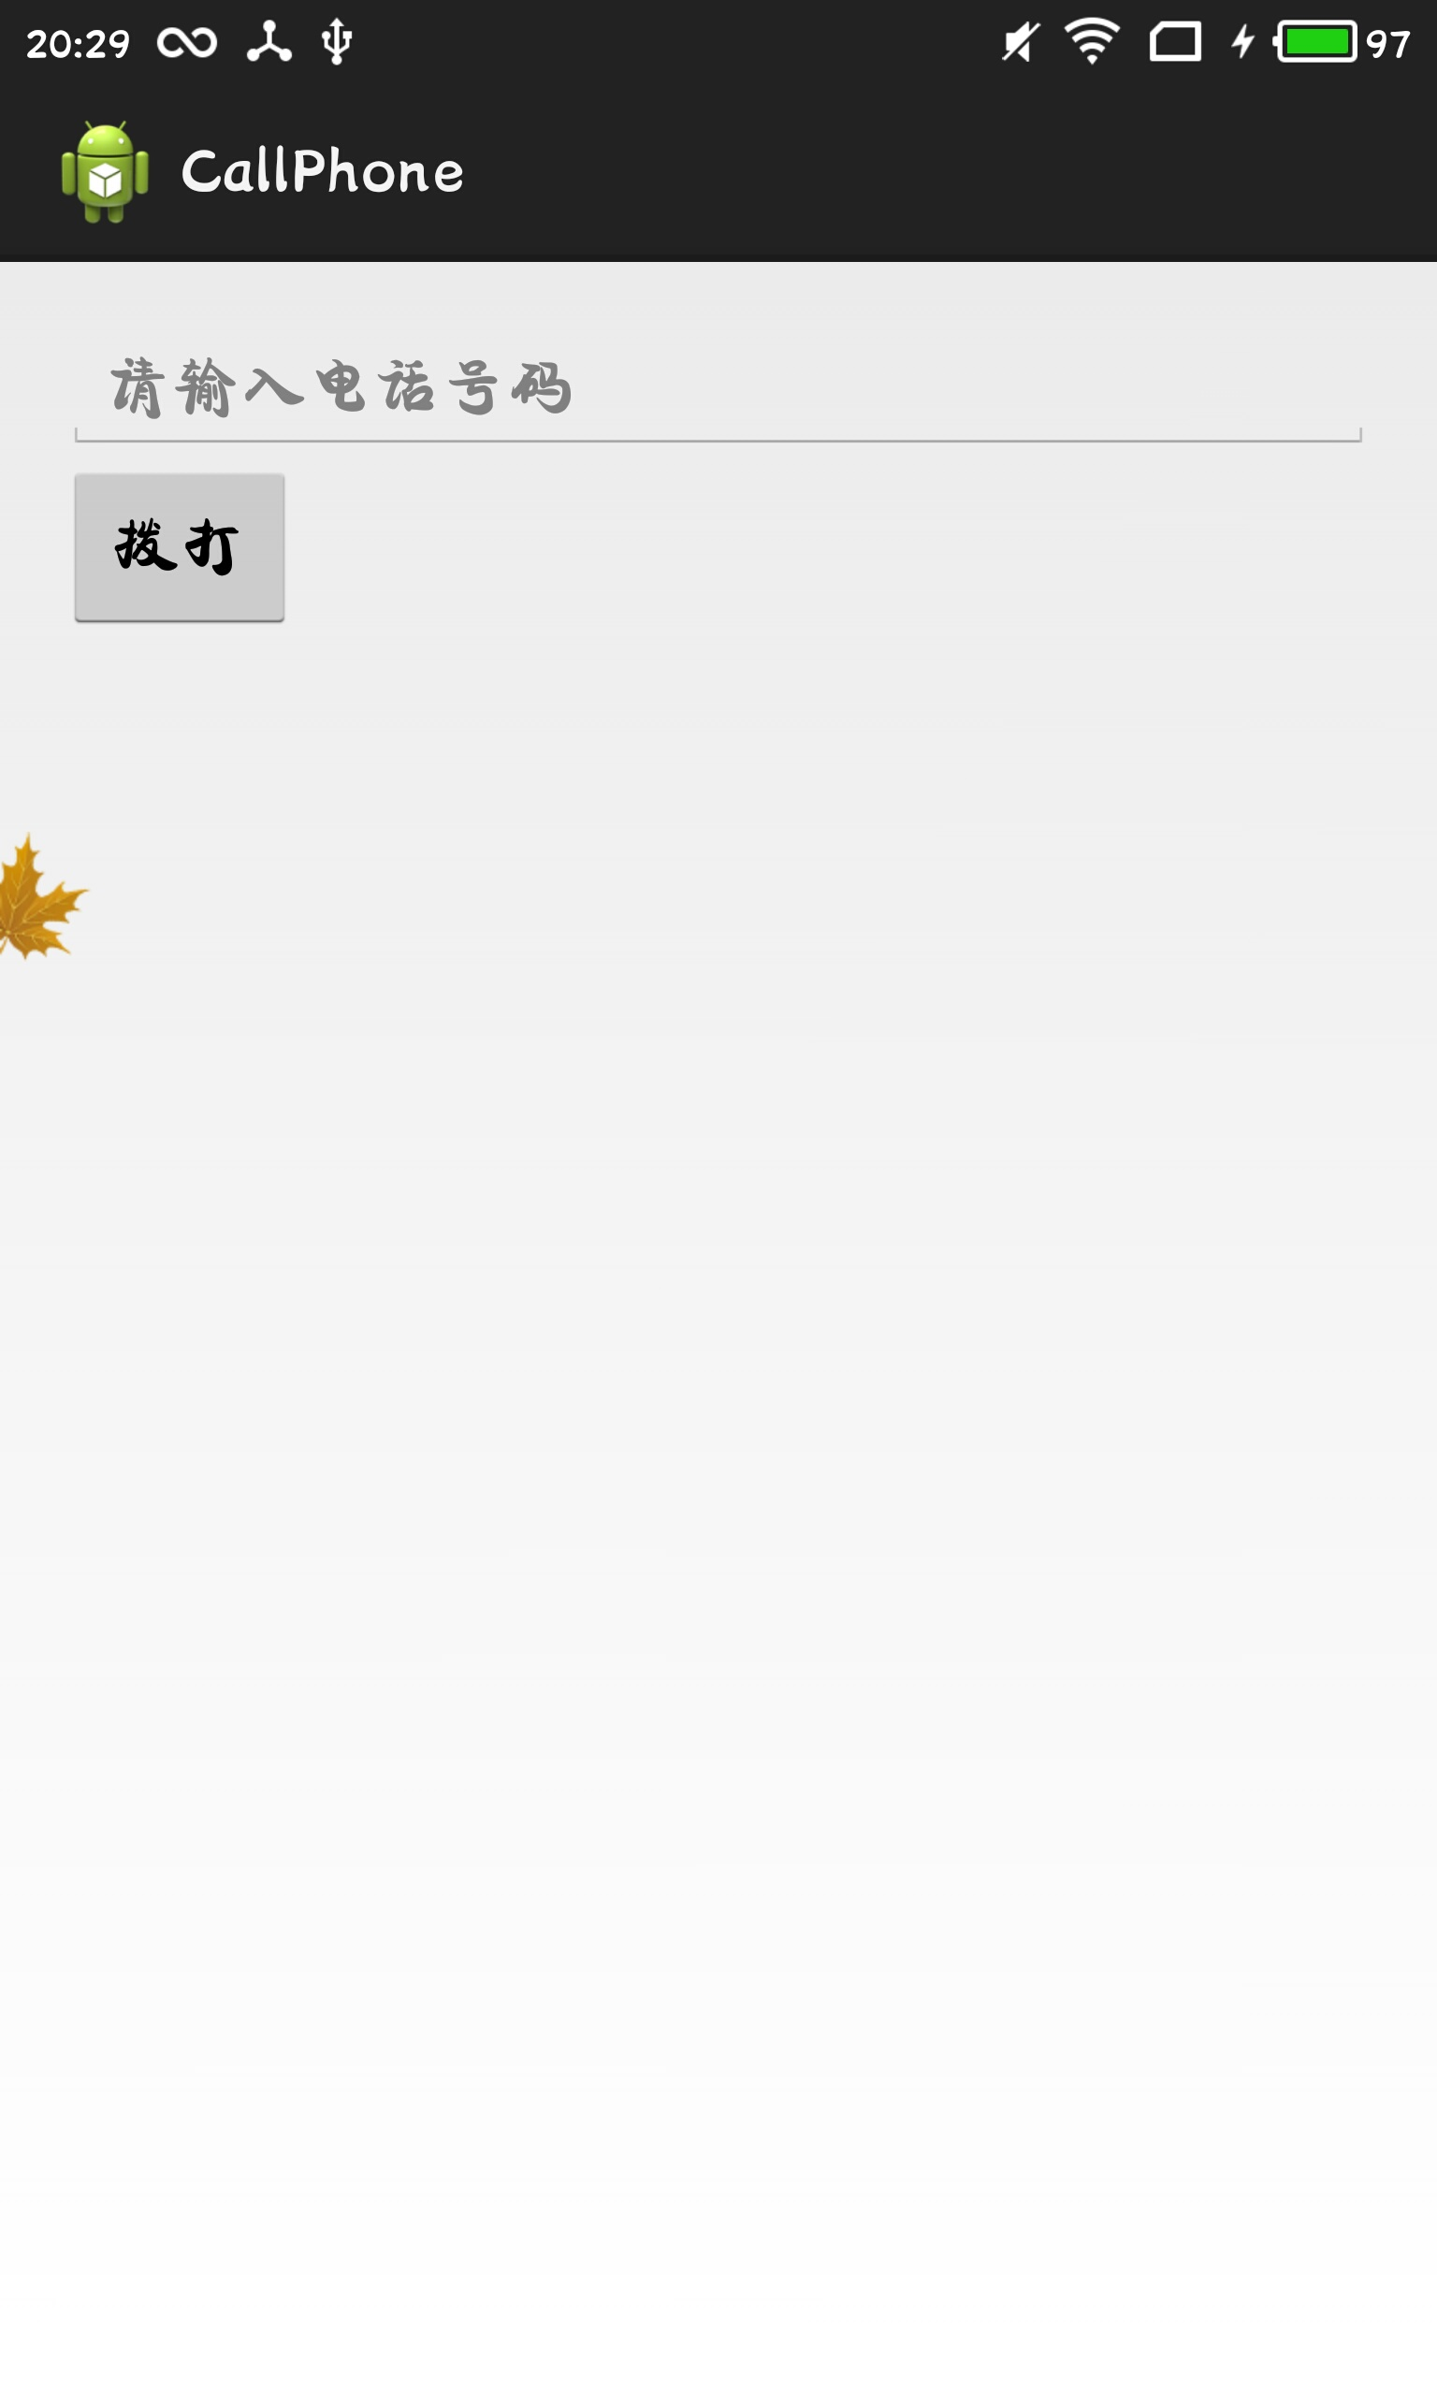
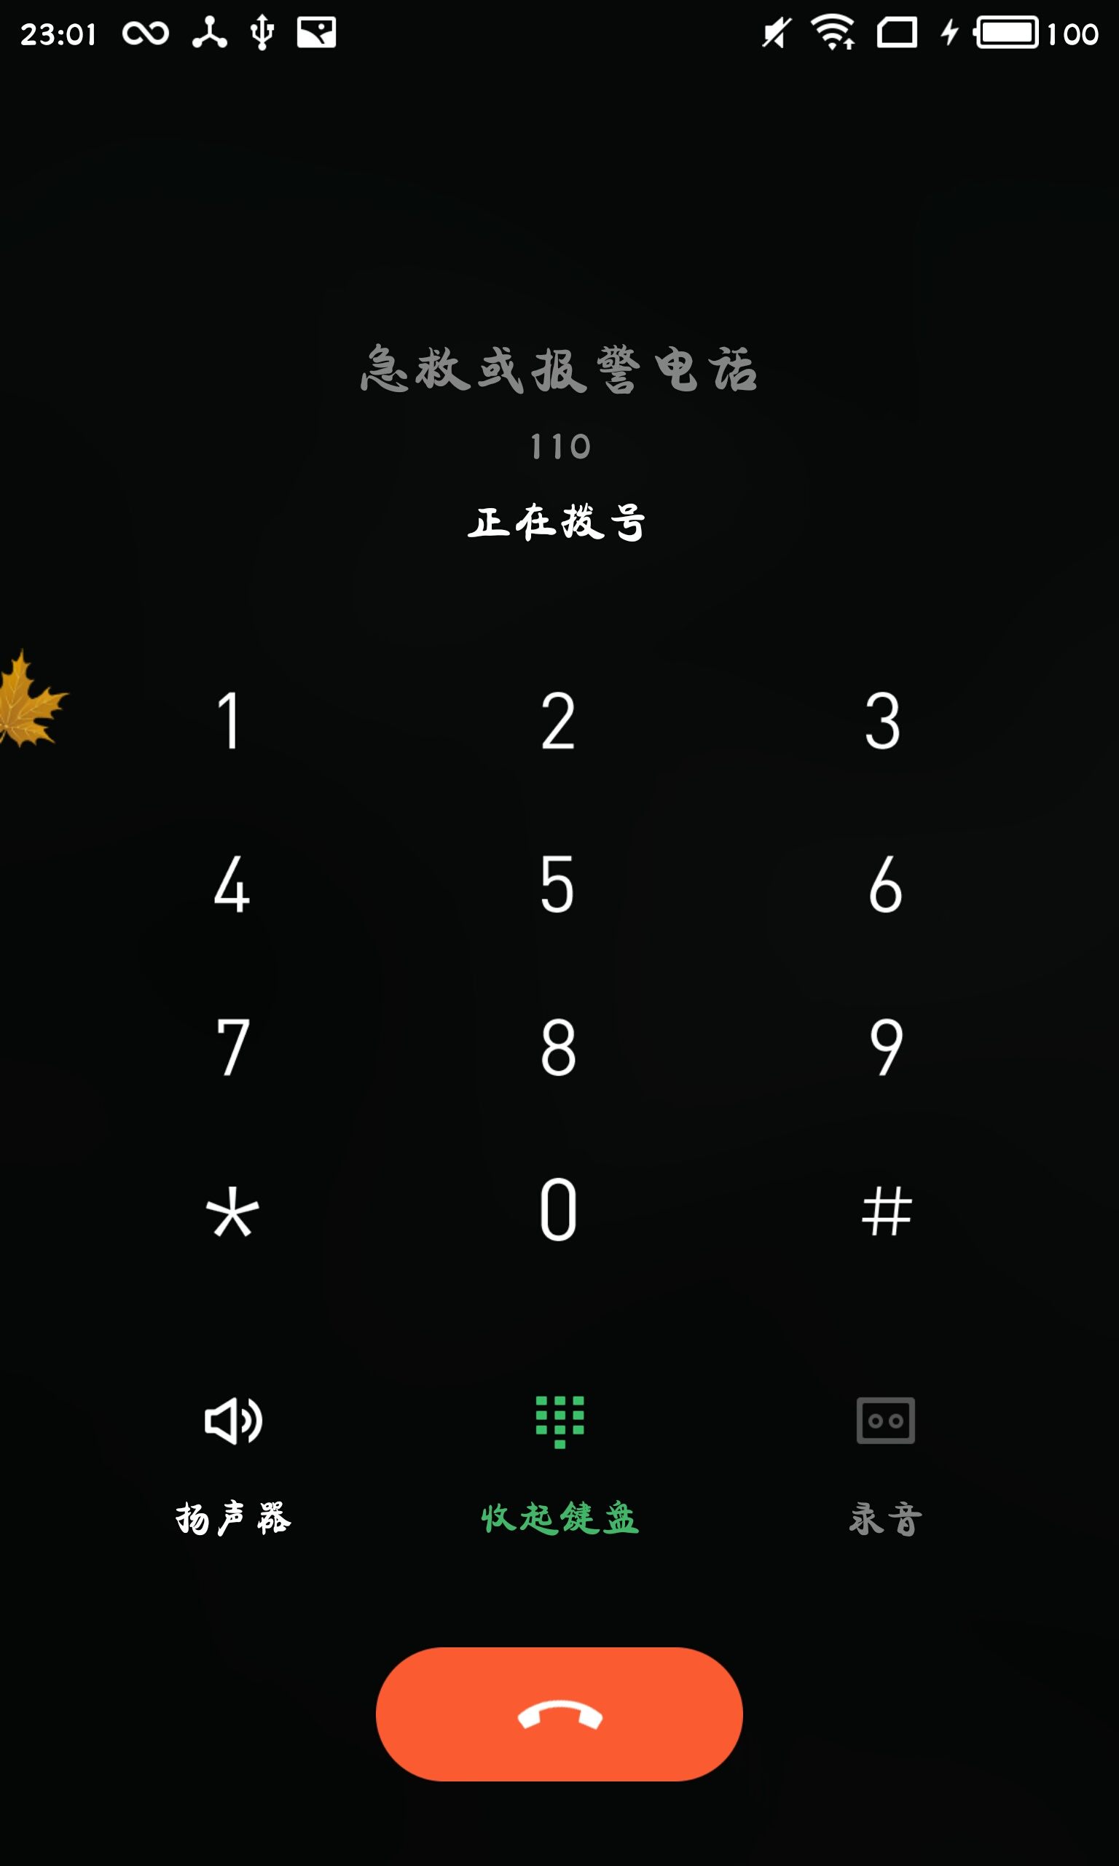
Programme 1: Call Phone

Slide 11
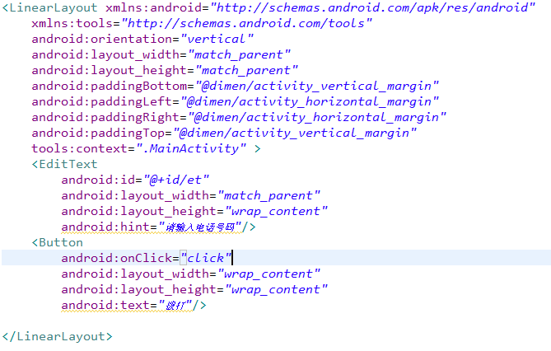
Programme 1:Layout Code

Slide 12
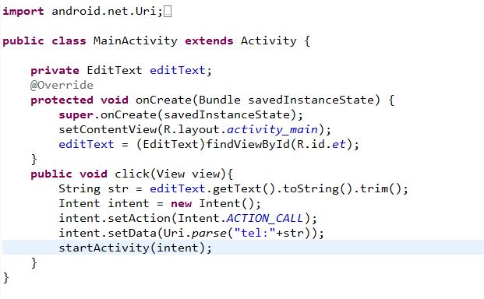
Programme 1:JAVA Code

Slide 13
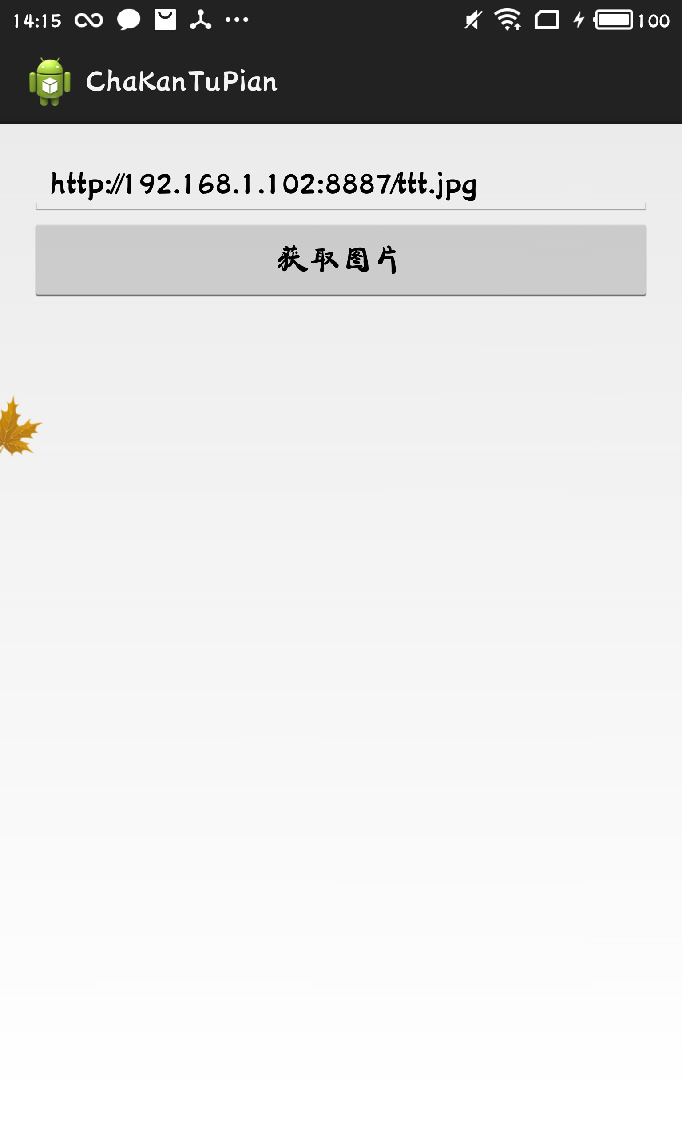
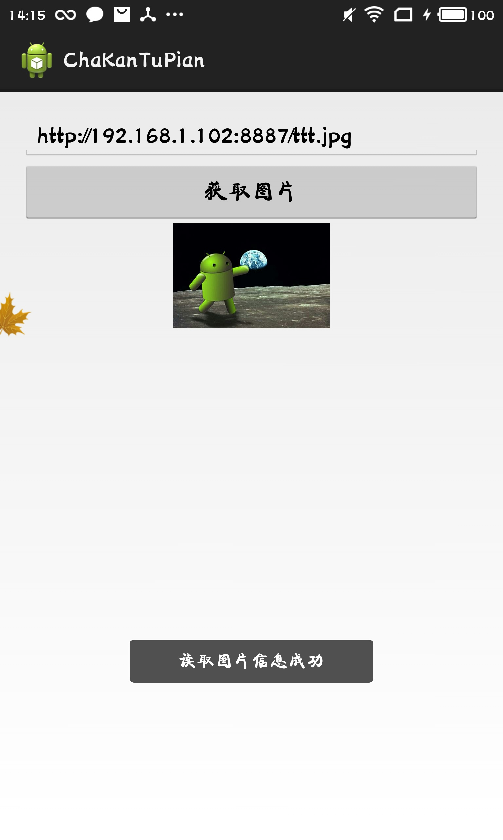
Programme 2:Get Website Picture
Click the button and Get the picture

Slide 14
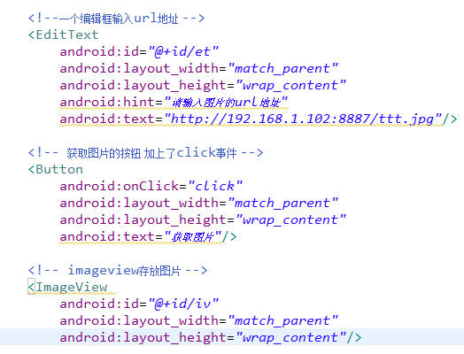
Programme 2 :Layout Code

Slide 15
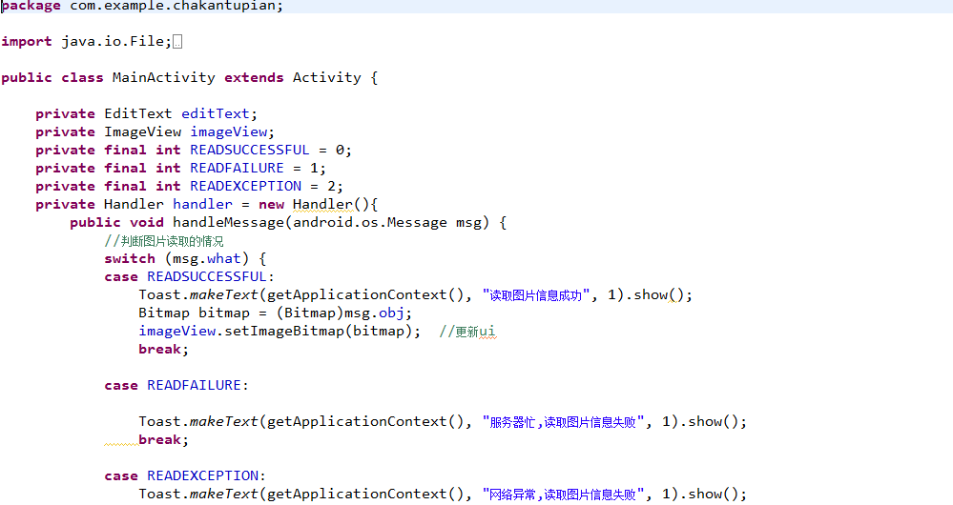
Programme 2:JAVA Code

Slide 16
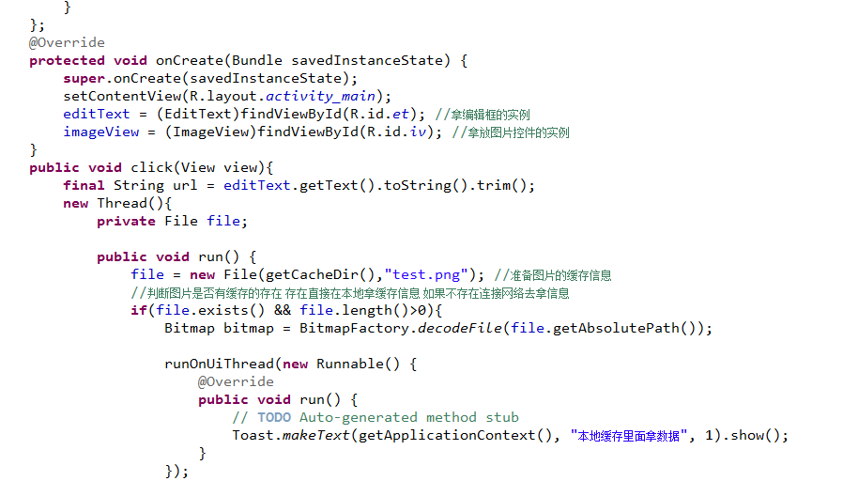
Programme 2:JAVA Code

Slide 17
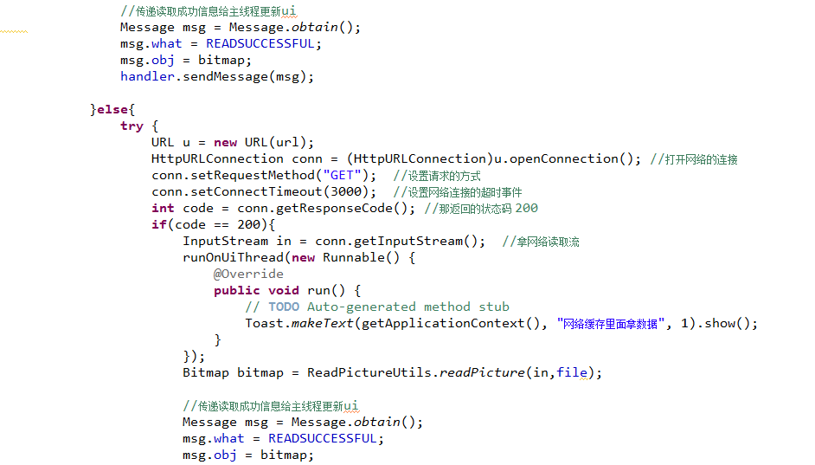
Programme 2:JAVA Code

Slide 18
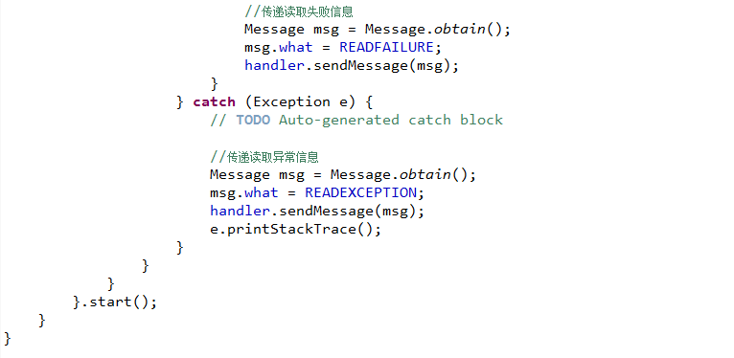
Programme 2:JAVA Code

Slide 19
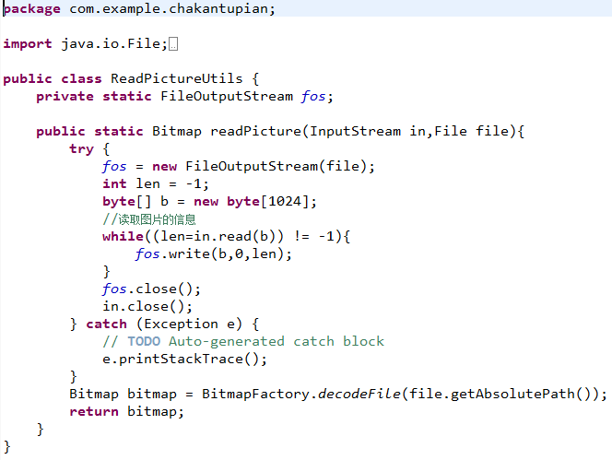
Programme 2:JAVA Code

Slide 20
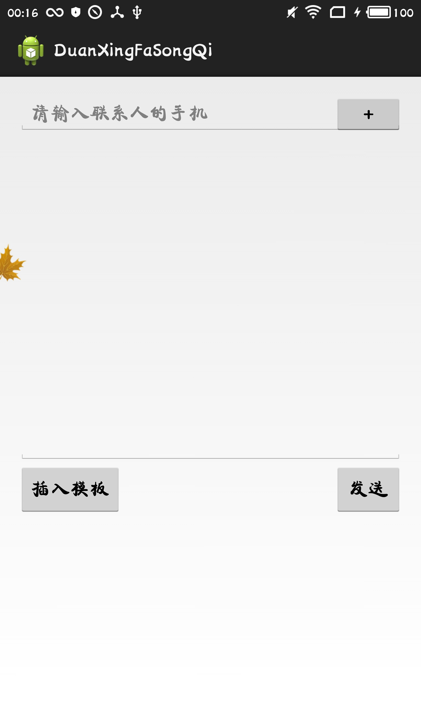
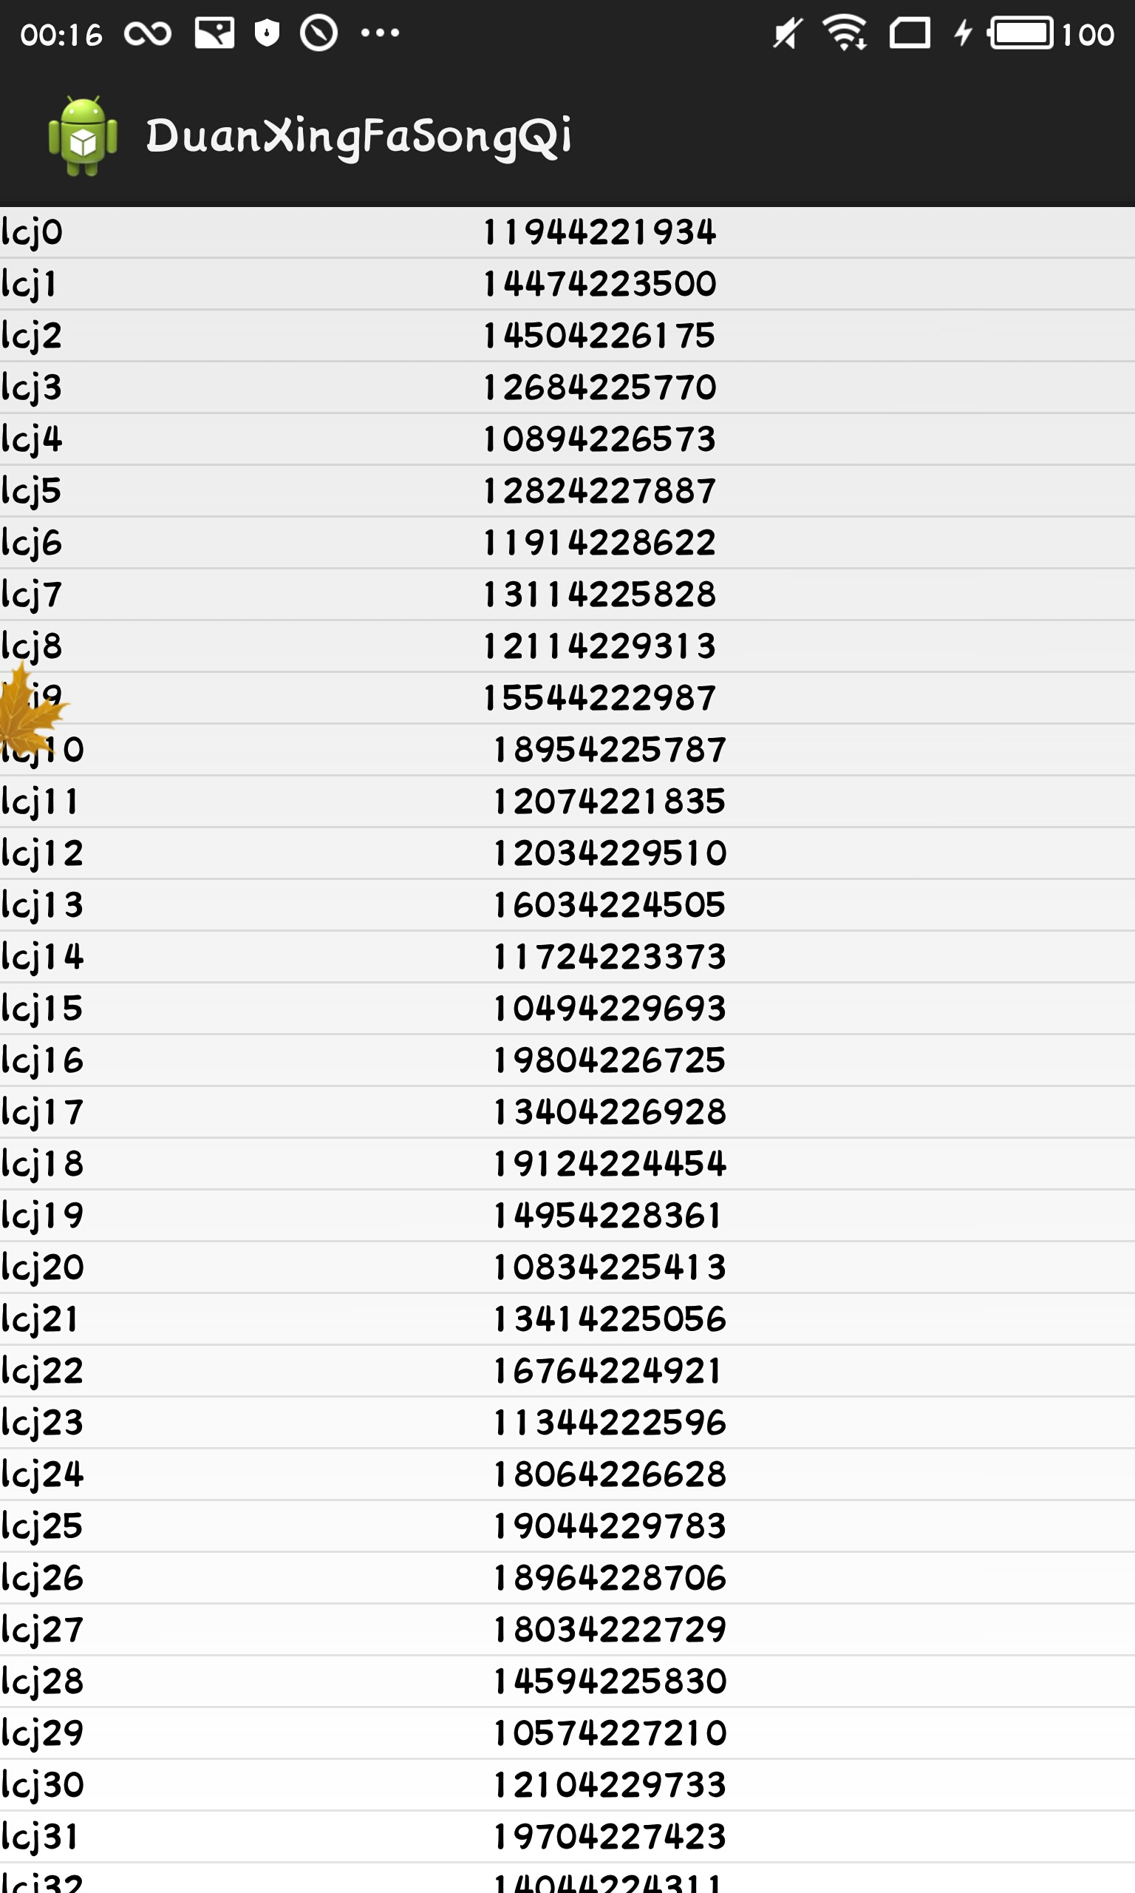
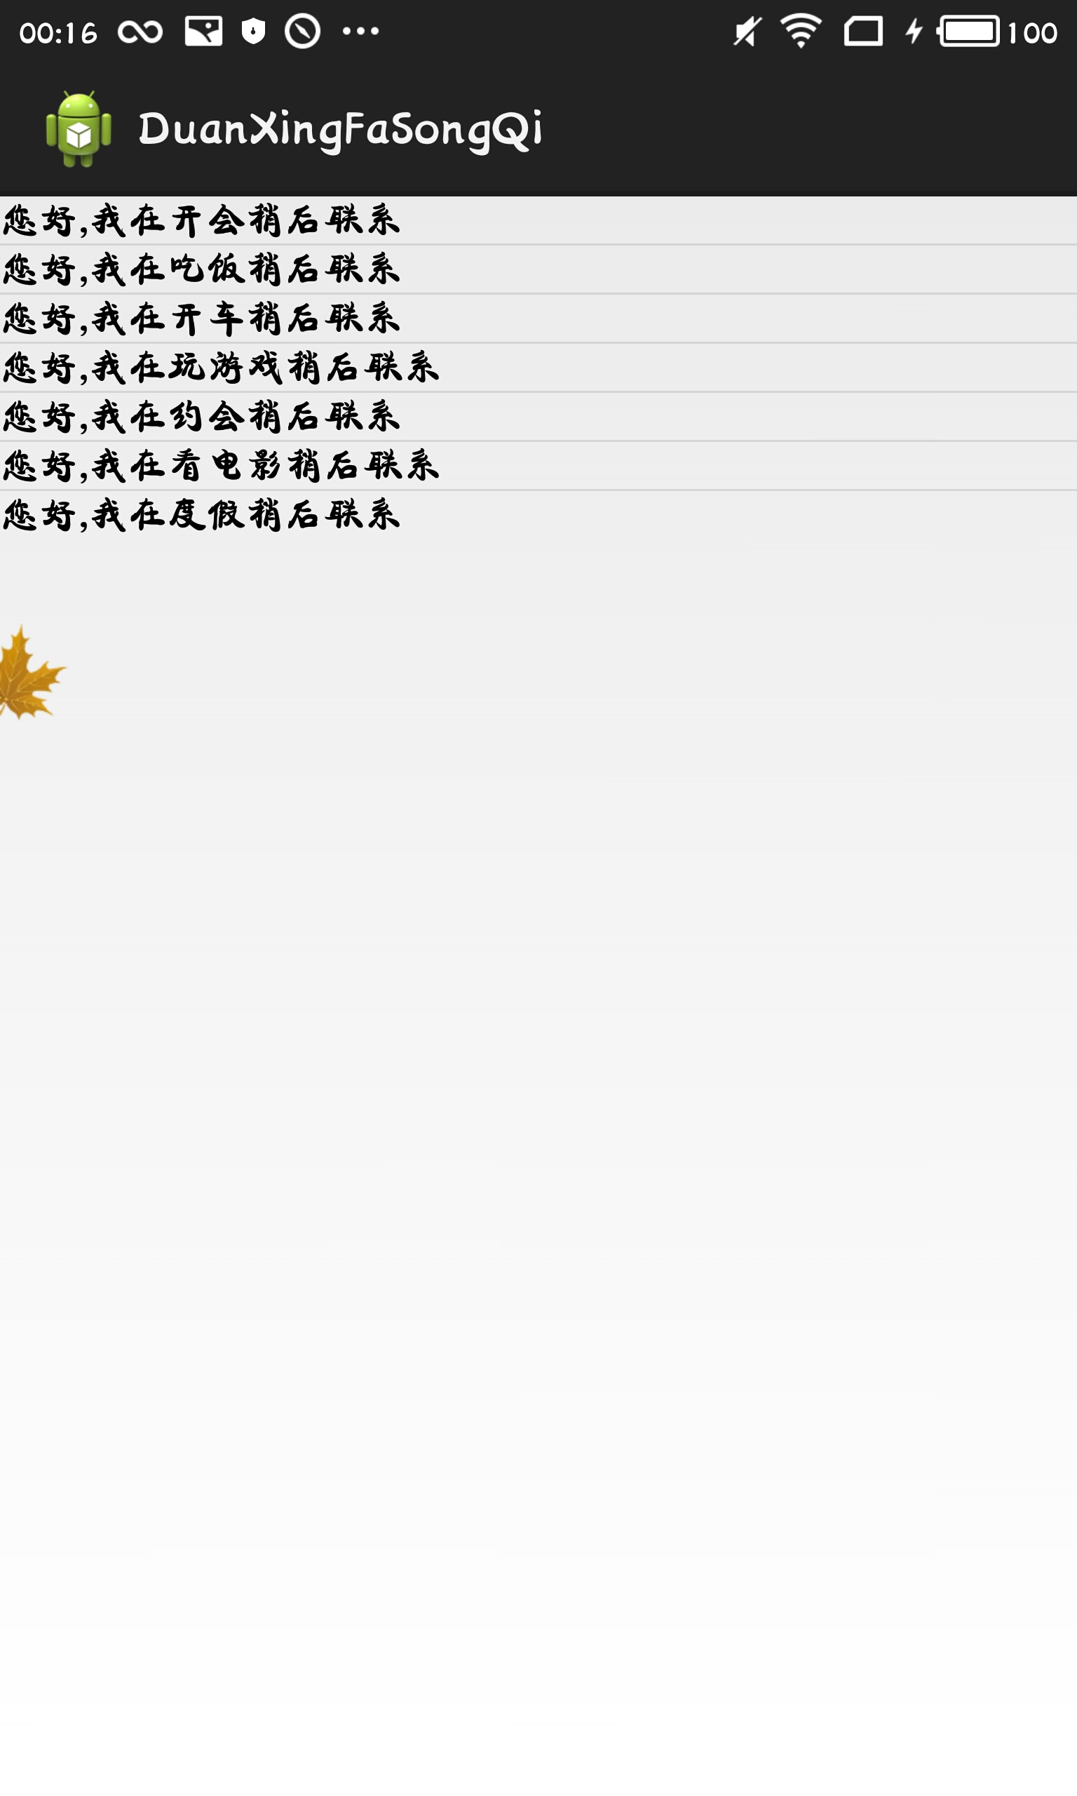
Programme 3: Send Message

Slide 21
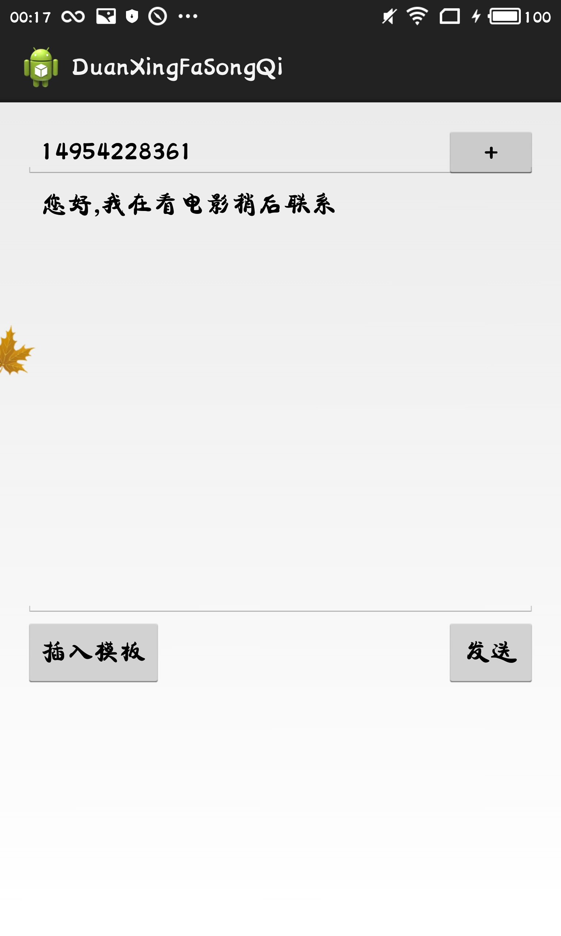
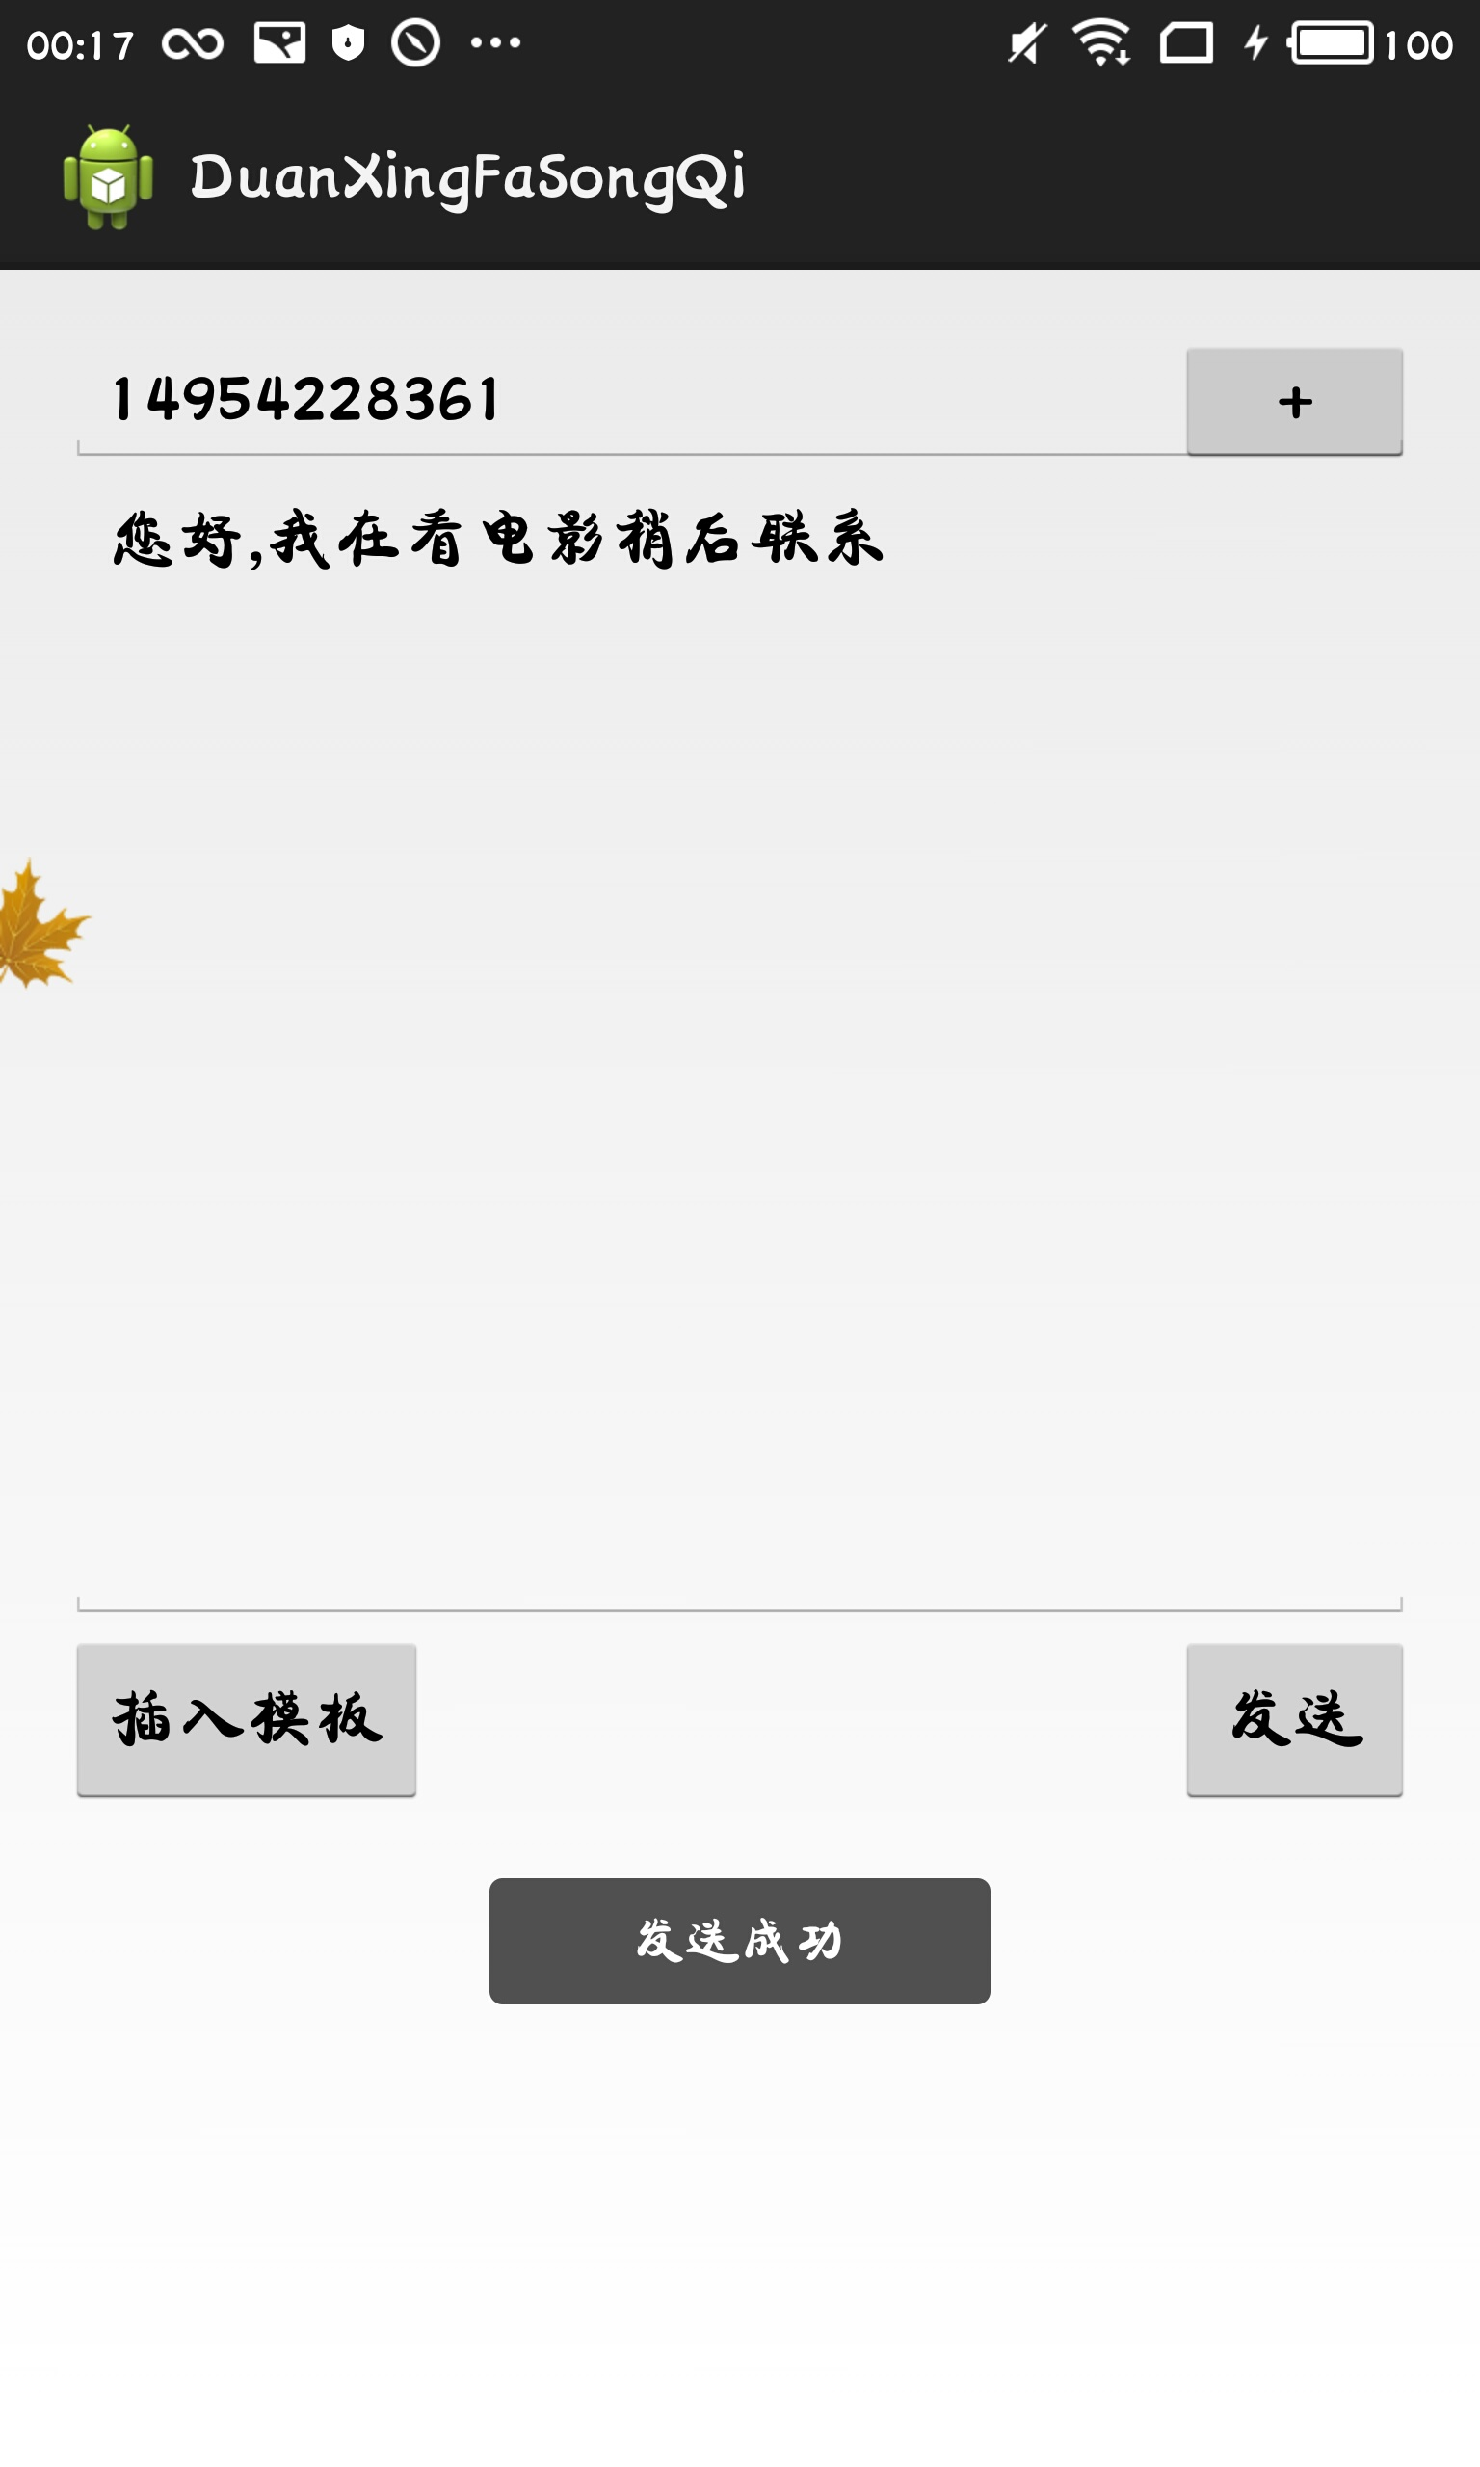
Programme 3: Send Message

Slide 22
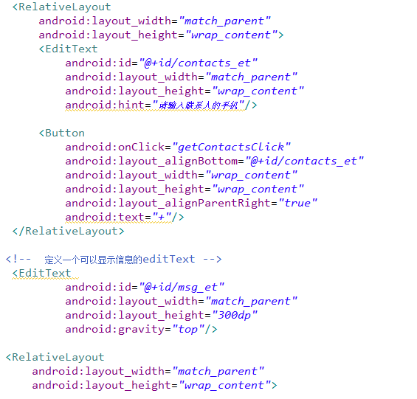
Programme 3 :Layout Code

Slide 23
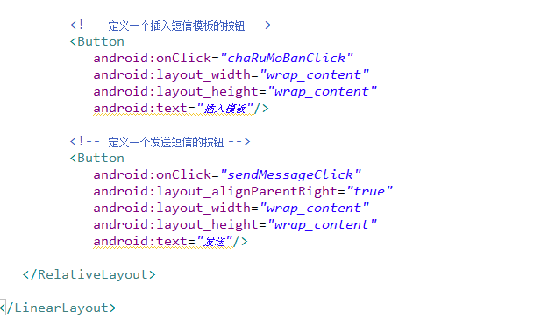
Programme 3 :Layout Code

Slide 24
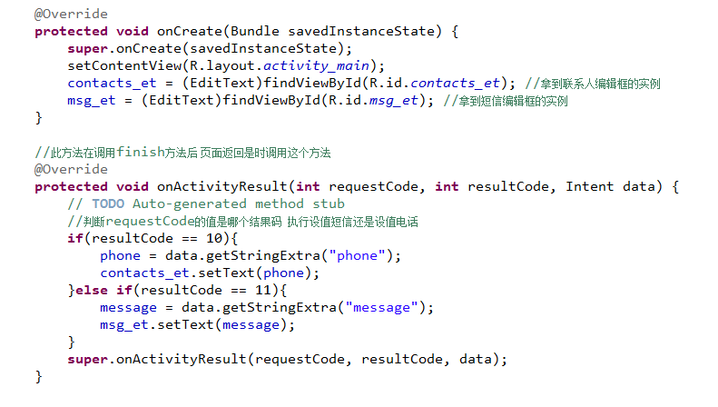
Programme 3:JAVA Code

Slide 25
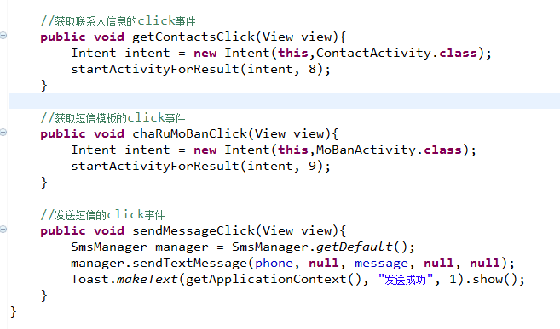
Programme 2:JAVA Code

Slide 26
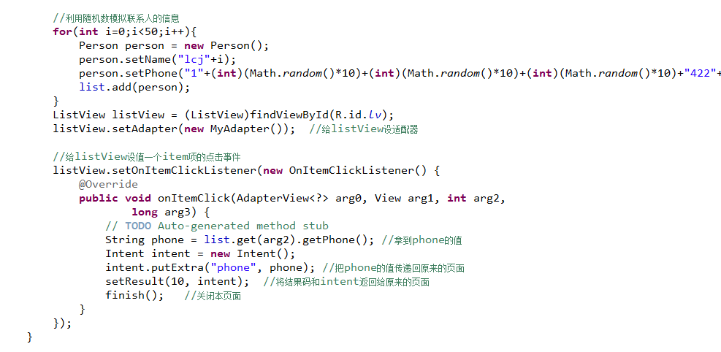
Programme 3:JAVA Code

Slide 27
Programme 3:JAVA Code

Slide 28
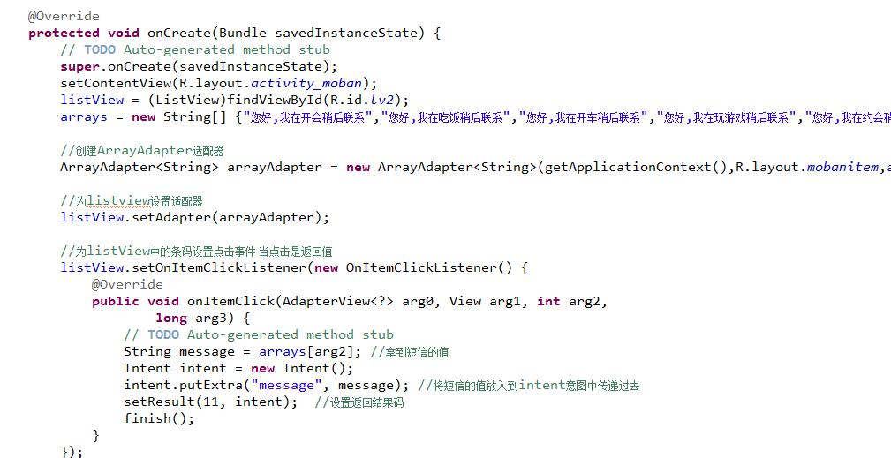
Programme 3:JAVA Code

Slide 29
Thanks！

